Slide 1
TEENAGE HEALTH

Slide 2
FOOD
Food is any substance that drivers our bodies.
These components make the food:carbohydr- ates,proteins,vitamins,fats and minerals. People produces food.Food need to eat every day. It mainly consists of animals or plants.Without food none of the living things can`t live. Developed food industries are meat,dairy, fishing and bakery.

Slide 3
TRAINING
You sholud trainig every day.Training brings people in form.You can lose weight.Training may be reached by sport.Training is good for health.People can train in gyms.

Slide 4
RULES FOR HEALTHY LIVING
1.You sholud be more move and practice.
2.You should eat healthy foods.
3.You sholud sleep at least 9 hour a day.
4.You should drink 6 glasses of water on day.
5.You shouldn`t eat junk food.
6.You sholud take a arest every day.
7.You sholudn`t eat spoiled food.

Slide 5
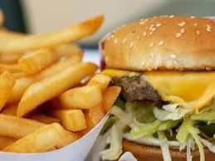
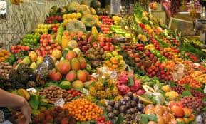
JUNK FOOD
HEALTHY FOOD

Slide 6
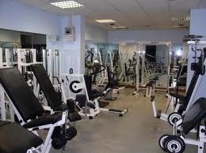
This is gym.

Slide 7
EAT HEALTY.

