Slide 1
TEENAGE HEALTH.

Slide 2
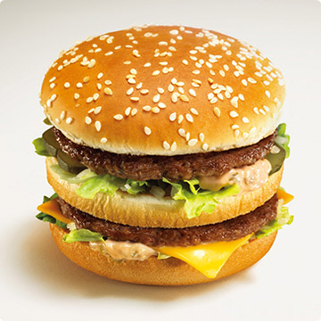
Food.
Teenagers often eat at fast-food restaurants, eat hamburgers, hot dogs, chips and pizza.
The consequences of unhealthy food:
Unhealthy food has poor quality, fatty, sweet, salt, fat and harmful foods.
This unhealthy foods can harm health teens.
Because of the lack vitamin teenagers are tired, sleepy, not concentrated, prone to infections and hyper.

Slide 3
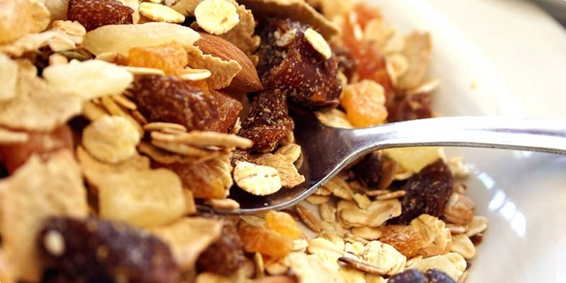
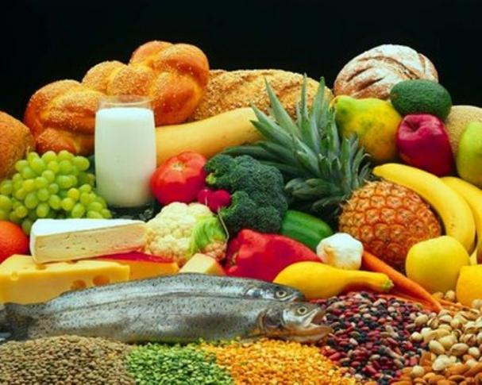
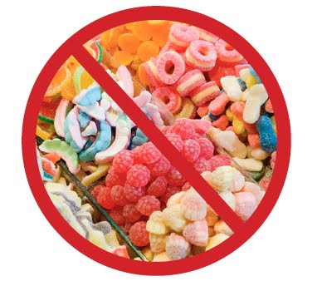
Teenagers need to eat healthy food!
Teenagers diet should be based on the different, quality and nutritious foods stored in the more diverse and healthier way.
Teenagers need a lot of cereals and cereal products, rice and beans, lots of fruits and vegetables, low-fat milk and dairy products, fish and eggs and less sweets and snacks.

Slide 4
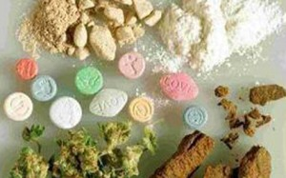
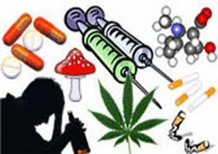
Drugs.
Drugs are bad for teenagers and destroy their brains.
Teenagers take drugs because they think that they doesn’t belong to this world, because they think no one loves them and because they think it will be less problems if they take drugs.
After the teens use drugs, they become addicted to drugs.
Teenagers who take drugs and you become dependent on drugs think it's hell without end.
Some teenagers take drugs out of curiosity, and after that they become addicted.
Addicts can stop taking the drugs with regular therapy and with medical assistance.

Slide 5
Rules for living a healthy life.
1. You should eat healthy food.
2. You should exercise.
3. You shouldn't eat a lot of sweets.
4. you should eat fruits and vegetables.
5. You shouldn’t eat at fast-food.
6. You shouldn’t take drugs.
7.You should play some sport.
8.You shouldn’t smoke cigaretts.

Slide 6
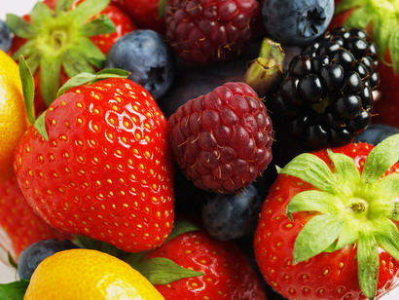
By:Petra Mitar.(;

